Slide 1
Android App Development
Parth Mahajan – Intern
Rajbirinder singh – Intern
Rashi Gupta – Intern
Taniya Saini - Intern
22 Feb 2018
The footer has suggested text only. Footer text should specify your external audience (example: For professional clients / qualified investors only) or make clear the presentation is for internal use only. To edit footer text, select INSERT, then Header & Footer.

Slide 2
Presentation Title Here (26pt bold)
This slide is for iShares decks only. Please delete if not needed. To add it back in, use the Layout key.
Presenter name / title here (16pt bold)
Date (14pt)

Slide 3
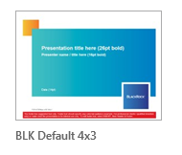
What has changed in the new PowerPoint template
Title slides – includes cover slides for both BlackRock and iShares
Content slide titles – bold, bright titles without a rule or shaded box
Color palette – new, expanded colors and tints
New bullet point style – simple, grey round bullets replace triangles
Retirement of the black background template – if your presentation will be projected, you will most likely be asked to use the White Widescreen template located on the network
Thumbnail preview of templates – easily find and open the template you need
Most importantly: the process for creating or converting slides has not changed.
Click on the links at the right for helpful step-by-step instructions.
Create and manage your presentation
Convert existing slides to new template
Top Tips and Tricks

Slide 4
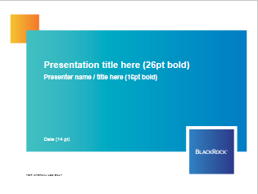

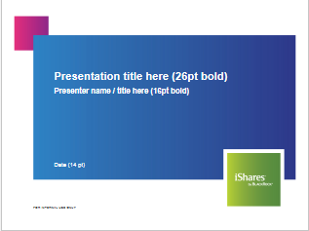

New brand colors
The new color palette brings the BlackRock & iShares brands closer together while still maintaining distinctiveness.
Consistent application of colors reinforces branding and presents cohesive visual messaging. When building a presentation apply these colors purposefully and in the ratios shown. For example, mostly blue, some teal and orange accent are used in BlackRock branded materials and mostly green, some blue and a magenta accent are used in iShares branded materials.
A balanced slide with plenty of white space allows the viewer to focus on your key content. Avoid crowding slides with too much information.
BlackRock
iShares

Slide 5
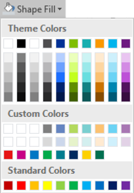
How to use the new color palette
Colors in the top row will be the default colors when creating charts and SmartArt
Avoid using these Microsoft-generated tints
DO use these company-approved tints
These are additional company-approved colors to be used selectively.
Magenta should ONLY be used in iShares presentations as an accent color
Avoid using these Standard Microsoft colors

Slide 6

Color values for reference
Custom Colors
G1
127, 127, 127
661-TINT1
102, 134, 191
376-TINT1
180, 215, 102
7466-TINT1
125, 207, 207
144-TINT1
251, 193, 119
298-TINT1
113, 211, 242
2613-TINT1
167, 121, 178
G2
217, 217, 217
661-TINT2
204, 215, 234
376-TINT2
230, 242, 204
7466-TINT2
212, 239, 239
144-TINT2
254, 234, 210
298-TINT2
208, 240, 251
2613-TINT2
226, 210, 229
BLK8-1797
PMS 1797
227, 27, 35
Accent color for use with
materials ONLY
IS7-233
PMS 233
197, 0, 132
300
PMS 300
0, 121, 193
355
PMS 355
0, 169, 79
3135
PMS 3135
17, 124, 142
654
PMS 654
0, 44, 95
115
PMS 115
252, 208, 21
342
PMS 342
0, 111, 81
NOTE:
When you hover over a custom color square, the corresponding Pantone (PMS) number appears

Slide 7
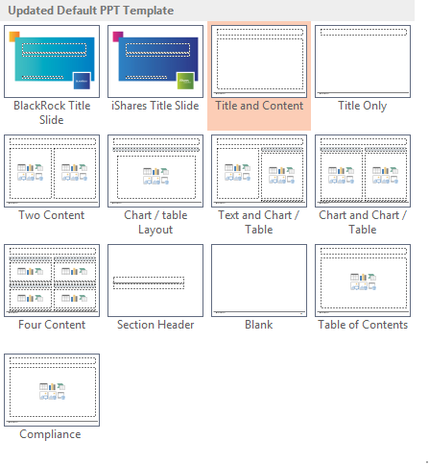
Choose the best layout for your content
When you insert a new slide (HOME > New Slide), a preview of each available layout will appear. Use the layout that best accommodates your content.
NOTE: The majority of your slides will likely use the Title and Content layout
Or
Title Only layout

Slide 8
Chart dos and don’ts
Charts should clearly illustrate the key points. Think of the audience first: “Will the viewer understand this chart?” Focus your message and remove extraneous data:
Consider which chart type best suits your data and message
Include only relevant data. Often it is effective to aggregate data, combine categories and focus on specific series or time periods. (If you are selective, be open and clear about this).
Remove distracting elements such as 3-D effects, borders, unnecessary axis lines and text, and weird data intervals such as 17, 34, 51 etc.
Other best practices include:
Use clear axis descriptions, sources and explanatory notes. Veer on the side of explaining more, rather than less. Aim for simplicity in legends and label chart lines directly as much as possible. Relegate details to the “Notes” section. Example: If you show U.S. high yield spreads over time, label the line in the chart “U.S. High Yield”. Explain in the “Notes” section that you are using the Barclays U.S. Corporate High Yield 2% Issuer Capped Index.
Use both a narrative and factual chart title. PowerPoints: Put the narrative title on the top of the slide and the factual title and time period above the chart (we have done this in the next four slides). Publications: Put the narrative title on top and the factual subtitle (including time period) below. Keep titles to one line.
Scale axes sensibly. Example: Do not show 100 years of history if your focus is events of the past six months. End a x-axis on the most recent year, otherwise you look out of date.
Triple-check your charts. An extra set of eyes can help avoid mistakes.
Use the BlackRock 200, our library of 500-plus real-time, downloadable charts. If you don’t, ensure up-to-date data from authoritative and primary sources.

Slide 9
Samples

Slide 10
Use clear lines charts with a limited number of series
Chart title, Arial 14pt
Arial, 14pt, bold
When to use: Comparing series over time and/or between variables
Avoid overlapping/tangled lines by limiting the number of series (lines) to four or fewer.
Label series directly when possible. If not, put a clear legend at the bottom.
If using both left and right axes, make sure to use clear labels to avoid confusion.
Arial
11pt
bold
0.75pt
R:134 G:134 B:134
No Y axis
2.25 pt
1.5PT
R:134, G: 134, B:134
TICK MARKS on line chart
Arial
11pt
SOURCES AND NOTES: ARIAL, 8PT
Insert source or footnote text here – 8pt regular

Slide 11
Use simple, uncomplicated bar charts
Chart title, Arial 14pt
Arial, 14pt, bold
When to use: Comparing magnitude (size) or a small number of time periods
Always start the vertical axis at zero.
Avoid using columns for multiple series unless you have fewer than four.
Arial, 14pt, bold
Arial
11pt
bold
0.75pt
R:134 G:134 B:134
No Y axis
Arial
11pt
1.5PT
R:134, G: 134, B:134
NO TICK MARKS on bar chart
SOURCES AND NOTES: ARIAL, 8PT
Insert source or footnote text here – 8pt regular

Slide 12
Always choose the chart type that is easiest to read
Chart title, Arial 12pt
Chart title, Arial 12pt
When to use: Rarely.
If you must use a pie chart, use five categories or fewer for clarity (see left chart).
Go from big to small clockwise, ending on a sum of smaller categories into an “other” bucket.
Make sure everything adds up to 100.
A horizontal bar chart is easier to read and often a better fit
Arial, 12pt, bold
Arial, 14pt, bold
1.5pt
R:134 G:134 B:134
Arial
11pt
SOURCES AND NOTES: ARIAL, 8PT
Insert source or footnote text here – 8pt regular
Insert source or footnote text here – 8 pt regular

Slide 13
Simple, clean tables are most effective
Chart title, Arial 14pt
Arial, 14pt, bold
When to use: Comparing specific valuations, performance or indicators at one or two points in time
Clearly separate rows and columns by using shading and headers, and do not overload with data.
Use proper symbols for individual data points; % if we mean a percentage, $ if we mean a dollar value.
Arial, 14pt, bold
Header
G1 (127,127,127)
 | Performance |  | Valuation
Equity Index | Q2 2015 | Last 12-Months | P/E Ratio | Dividend Yield
U.S. S&P 500 | 0.3% | 7.4% | 16.9 | 2.1%
Euro Stoxx | -4.2% | 12.1% | 15.8 | 2.5%
UK FTSE 100 | -2.8% | 0.2% | 15.6 | 3.7%
Japan Topix | 5.8% | 31.6% | 15.7 | 1.6%
MSCI China | 6.2% | 25.0% | 11.1 | 2.6%
MSCI World | 0.5% | 2.0% | 16.6 | 2.5%
MSCI Emerging | 0.8% | -4.8% | 11.9 | 2.6%
Subhead
G2 (217,217,217)
Highlights
G3 (242,242,242)
No outside border
3/4pt, G1 (127,127,127)
Arial
11pt
No outside border
SOURCES AND NOTES: ARIAL, 8PT
Insert source or footnote text here – 8pt regular

Slide 14
Sample Org Chart layout using tints of PMS 661 blue
Name
Title or Organization
Name
Name
Name
Name
Title or Organization
Title or Organization
Title or Organization
Title or Organization
Name
Name
Name
Title or Organization
Title or Organization
Title or Organization
Name
Using tints of a single color with a neutral gray is a sophisticated application of color that visually emphasizes the structure of the chart
Title or Organization
Name
Title or Organization
Name
Title or Organization

Slide 15
Divider title here – sentence case (24pt)
Subtitle here if required (16pt)

Slide 16
Note to User:
This is a standard compliance page for general presentations only
The following notes should be read in conjunction with the attached document:
Issued by BlackRock Investment Management (UK) Limited, authorised and regulated by the Financial Conduct Authority. Registered office: 12 Throgmorton Avenue, London, EC2N 2DL. Tel: 020 7743 3000. Registered in England No. 2020394. For your protection telephone calls are usually recorded. BlackRock is a trading name of BlackRock Investment Management (UK) Limited.
Past performance is not a guide to future performance and should not be the sole factor of consideration when selecting a product. All financial investments involve an element of risk. Therefore, the value of your investment and the income from it will vary and your initial investment amount cannot be guaranteed. Changes in the rates of exchange between currencies may cause the value of investments to go up and down. Fluctuation may be particularly marked in the case of a higher volatility fund and the value of an investment may fall suddenly and substantially. Levels and basis of taxation may change from time to time.
Mandates we manage may be exposed to finance sector companies, as a service provider or as counterparty for financial contracts. In recent months, liquidity in the financial markets has become severely restricted, causing a number of firms to withdrawn from the market, or in some extreme cases, becoming insolvent. This may have an adverse affect on the mandates we manage.
Any research in this document has been procured and may have been acted on by BlackRock for its own purpose. The results of such research are being made available only incidentally. The views expressed do not constitute investment or any other advice and are subject to change. They do not necessarily reflect the views of any company in the BlackRock Group or any part thereof and no assurances are made as to their accuracy.
This document is for information purposes only and does not constitute an offer or invitation to anyone to invest in any BlackRock funds and has not been prepared in connection with any such offer.
This material is for distribution to Professional Clients (as defined by the FCA Rules) and should not be relied upon by any other persons.
Subject to the express requirements of any client-specific investment management agreement or provisions relating to the management of a fund, we will not provide notice of any changes to our personnel, structure, policies, process, objectives or, without limitation, any other matter contained in this document.
No part of this material may be reproduced, stored in retrieval system or transmitted in any form or by any means, electronic, mechanical, recording or otherwise, without the prior written consent of BlackRock.
UNLESS OTHERWISE SPECIFIED, ALL INFORMATION CONTAINED IN THIS DOCUMENT IS CURRENT AS OF {DATE].
PLEASE NOTE THIS IS A GENERIC DISCLAIMER.
For a product-specific disclaimer: go to File > New > Office365 > BlackRock Templates Letter
The file is called: “Compliance Pages Only”

